Slide 1
Safe Asynchronous Programming: Methodology, Language, and Tools
Introduction
PLDI 2019 Tutorials

Slide 2
Presenters
Pantazis Deligiannis, Microsoft Research, Redmond
Ankush Desai, University of California, Berkeley
Akash Lal, Microsoft Research, Bangalore
Shaz Qadeer, Facebook, Menlo Park

Slide 3
Tutorial Outline
Part 1 (09:00 - 10:00) : Introduction to the P language.
Introduction, evolution of P, and an overview of the P language
Part 2 (10:00 – 11:00): P# Runtime.
Introduction and a tutorial on the P# programming framework, a C# runtime for P.
Part 3 (11:20 – 12:30): Building Distributed Services using P#
Building reliable distributed services using P# and the Reliable State Machines (RSM) framework (at Microsoft Azure) .
Part 4 (14:00 – 15: 30): Safety Testing of Async. Systems.
From scalable monolithic to compositional testing of asynchronous systems.
Part 5 (16:00 – 17:00): Liveness Testing of Async. Systems.
Specifying and Finding liveness violations in real-world distributed systems.

Slide 4
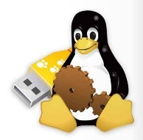
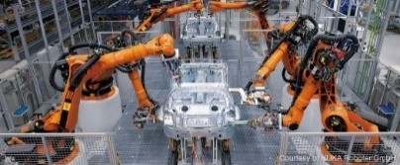


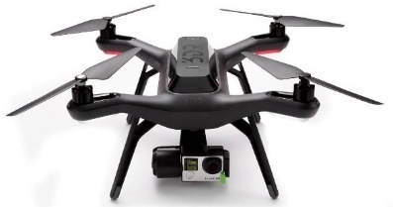

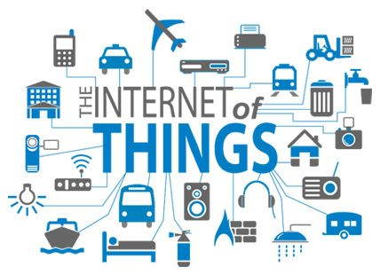
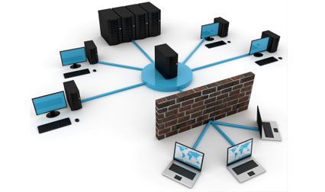
Event Driven Asynchronous Systems
Operating System, Device-Drivers, Web-Applications.
Industrial Automation, Robotic System, Cyber Physical Systems.
Distributed Systems, Distributed Storage.
Internet of Things.
Notes:
Most of the applications across domains are event-driven in nature consisting of processing communicating with each other by sending messages.
Device drivers in OS, web-app are event-driven.
Distributed systems by contruction are event-driven in nature as nodes communicate by sending messaging.
More recently, robotic applications are becoming more and more complex and are implemented as concurren event-driven systems.
To summarize, the paradigm of event-driven programming is becoming popular across domains as the applications are becoming more and more parallel and distributed in nature.

Slide 5
Characteristics of Event Driven Systems
Event-Driven Asynchronous System (actor model):
Collection of concurrently executing processes.
Processes can be created dynamically.
Processes communicate by asynchronously sending messages or events to each other (no shared memory).
Reactive Systems:
Processes in the system interact continuously with the environment.

Slide 6

Programming Event Driven Systems is Challenging
Non-determinism
Non-determinism
Sensor Failure
Node Failure
Uncertainties
Uncertainties
Fault Tolerance
Environment
Modeling
Fault Tolerance
Environment
Modeling
Message Loss
Message Loss
Reactivity
Reactivity
Safety
Specifications
Synchrony
Liveness!
Partial-Synchrony
Partial-Synchrony
Concurrency
Concurrency
Complex Interaction
Aynschrony
Composition
Multiple Components

Slide 7
Overview: P Framework
P Program
Implementation
Specification
Abstractions
Test
P Framework
P: State machine based language for safe event-driven programming [PLDI 2013].
P#: Asynchronous programming, analysis and testing with State machines in C# [PLDI 2015].
Modular P: Implements a module system for hierarchical and compositional reasoning [OOPSLA 2018].

Slide 8
Overview: P Framework
P Program
Implementation
Specification
Compiler
Toolchain
Abstractions
Test
Intermediate Code
Systematic
Testing
Tool
(Reproducible) Error Trace
P Framework
Scalable Analysis of Event-Driven Programs:
Search Prioritization and Random Testing [FSE 2015], [PLDI 2015].
Lasso Detection for Liveness Testing [FMCAD 2017]

Slide 9
Overview: P Framework
P Program
Autogen C Impl.
Deployment
tool
Autogen Impl.
P
Runtime
Wrappers
Implementation
Wrappers
Specification
OS, Libs
Compiler
Toolchain
Abstractions
Target Platform
Test
Intermediate Code
Systematic
Testing
Tool
(Reproducible) Error Trace
P Framework
Build Safe Real-World Systems:
Windows Device Drivers (USB 3.0) [PLDI 2013, OOPSLA 2014]
Fault Tolerant Distributed Systems [FAST 2016, OOPSLA 2018, ECOOP2019].
Safe Robotic Systems [ICCPS 2017, DSN 2019]

Slide 10
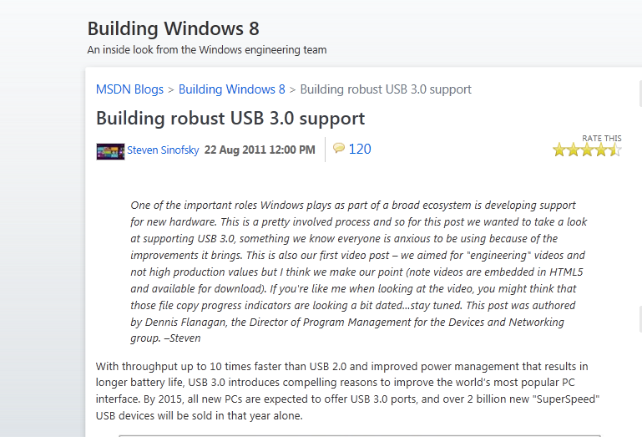
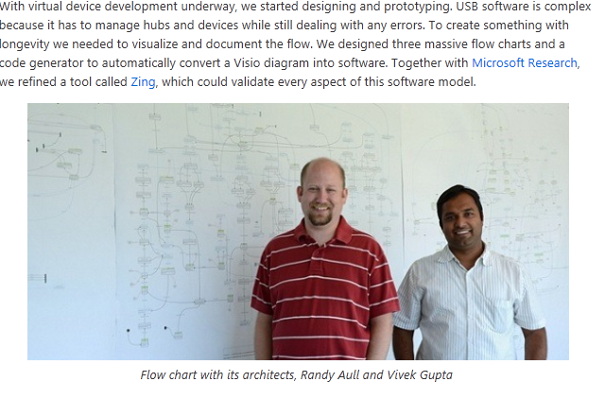
Origin of P (USB 3.0)

Slide 11
Evolution
2013: Methodology and programming model developed
2014: First compiler with C and Zing backend
2015: P# provides methodology in C# on .NET
2016-2018: Gradual adoption of P# in Azure services
2018: P modules designed and new compiler targeting C and P#

Slide 12
Teams that Used/Adapted P
P Drivers
USB host
USB function
UART class extension
Hid class
USB Type C stack
Media Agnostic USB
Bluetooth
…
P# Services
Batch (>1)
Blockchain (>1)
PreProvisioning
AzMove
Custom implementations of P model
in two services in Office and Azure

Slide 13
Lessons
“Connecting specifications to executable code is difficult”
even if the goal is less ambitious than full proof
“Nondeterminism is pervasive in concurrent and distributed systems”
runtimes must be designed with control in mind; too difficult to add later
“Getting a new language adopted is difficult”
even if you have the most amazing feature X; practically Y₁, …, Y_{n} are also needed
“Compiler and runtime are two different things”
usable runtime is prerequisite for a usable compiler

Slide 14
P/P# in relation to …
Key capabilities not found together in any other system:
Programming model and implementation based on asynchronous communicating state machines.
Controlled concurrency testing against safety and liveness properties and reproducible error traces.
Modules for compositional reasoning
What about model checkers (SPIN, TLA, ..)?
No methodology for connecting models and specifications to executable code
What about fuzzers (Jepson, …)?
No modeling or specifications
Error traces are not reproducible

